Slide 1

Evaluating Gam’s from the mgcv R package
Sam Kloese, acas, cspa, maaa, cpcu, dtm

Slide 2
agenda
Introduce pricingame dataset
Build GAM
Evaluate GAM

Slide 3
Dataset
Part of CASdatasets package
Actuarial Datasets
Originally for “Computational Actuarial Science with R” Book
French Motor Third-Party Liability Datasets used for Data Science Game
Using tables pg17trainpol and pg17trainclaim
Data Size
100,000 rows
34 columns
16,445 claims
Columns:
Policy Coverage (pol_coverage): Mini, Median1, Median2, Maxi
Policy Usage (pol_usage): WorkPrivate, Professional, Retired, AllTrips
Driver Age 1 (drv_age1): Driver age of the first driver
Vehicle Age (vh_age): Difference between current year and release year
Motor Power (vh_din): Representation of motor power (13-200)
Vehicle Weight (vh_weight): Measured in kilograms (0-7,901)

Slide 4
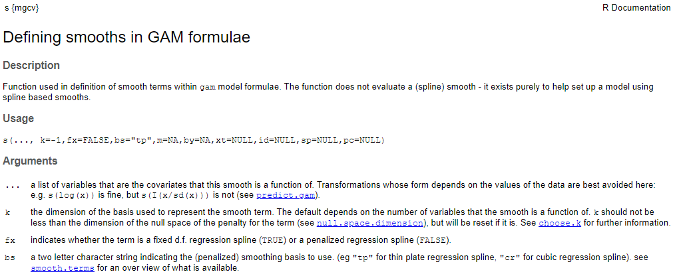
Single Variable smooths
Columns to smooth are wrapped in “s( )”
The smooth type is controlled by the bs argument
The default smooth type is thin plate (bs = “tp”)
Cubic spline is another option (bs = “cr”)
The argument k determines the number of basis functions

Slide 5
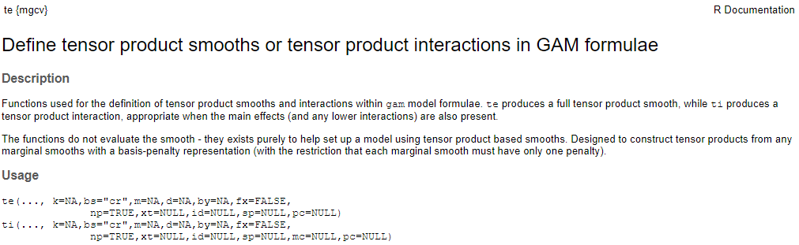
Tensor interaction smooths
Tensor interaction models pure interaction effect on top of the main effect
Tensor smooths are useful when the 2 variables have different scales
Experimenting with motor power and vehicle weight
Motor Power: Age: 13-200
Vehicle Weight : 0-7901 kilograms

Slide 6
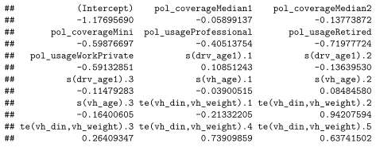

Tensor Interaction smooth
Two non-smoothed terms
Policy Coverage
Policy Usage
Two smoothed main effect terms
Driver Age 1
Vehicle Age
One smoothed interaction term
Motorpower & Vehicle weight

Slide 7
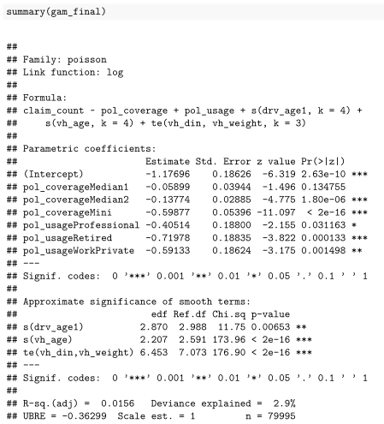
Summary() on the Model Object
Two non-smoothed terms
Policy Coverage
Policy Usage
Two smoothed main effect terms
Driver Age 1
Vehicle Age
One smoothed interaction term
Motorpower & Vehicle weight

Slide 8
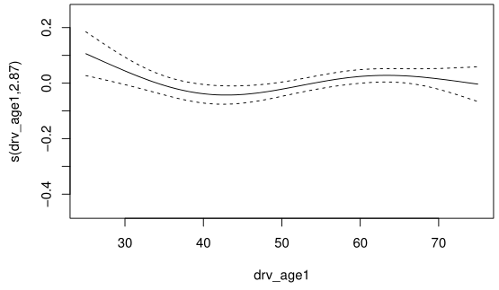
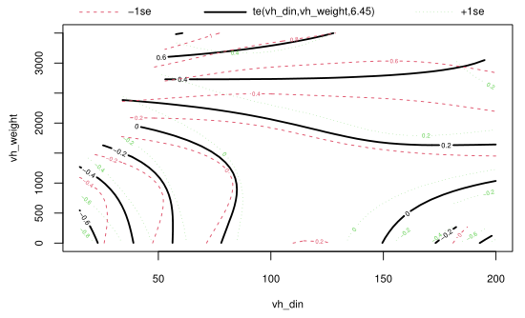
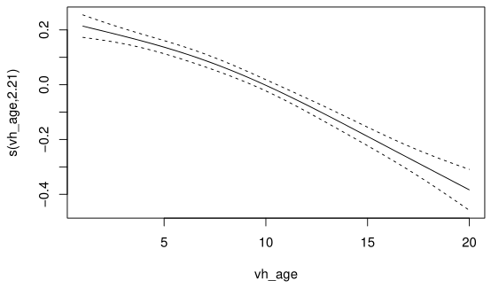
Default plot smooths

Slide 9


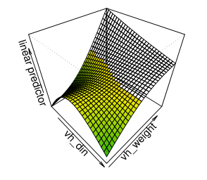
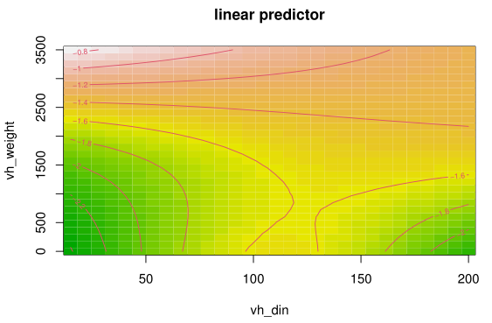
Tensor Interaction smooth

Slide 10
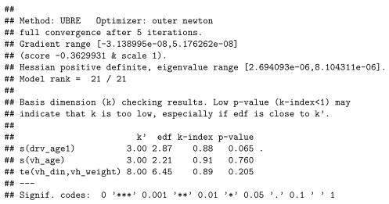
Gam.check() Automated results
We want HIGH values for these p-values
We are checking if one of the smooths is predictive of the residuals
We sure hope it isn’t!
We want higher k-index values

Slide 11
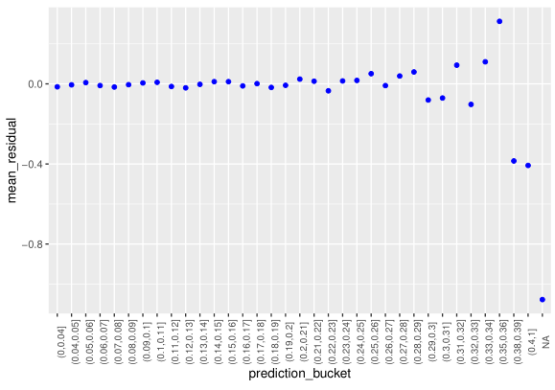
Average residual by predicted value
Residual = actual frequency – predicted frequency
Blue dots are the average residual
X-axis is 1% intervals of predicted values
We want to see mean residuals near 0 across low and high predictions

Slide 12
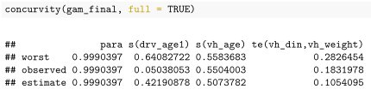
Concurvity() on the model object
Worst, observed, estimate are different measurements of concurvity
Worst is the most pessimistic
Rule of thumb:
Worst case concurvity > 0.8 is too much

Slide 13
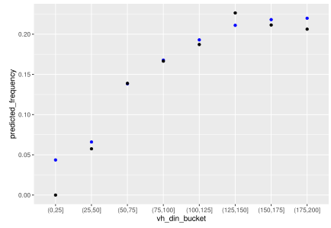
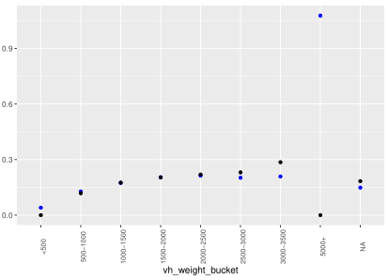
Actual vs. Expected plots
Blue – Predicted Frequency
Black – Actual Frequency

Slide 14
Iterative AIC
Model | AIC
~Policy Coverage | 75,753
~Policy Coverage + Policy Usage | 75,422
~Policy Coverage + Policy Usage + s(Driver Age) | 75,406
~Policy Coverage + Policy Usage + s(Driver Age) + s(Vehicle Age) | 75,118
~Policy Coverage + Policy Usage + s(Driver Age) + s(Vehicle Age) + te(Vehicle Din, Vehicle Weight) | 74,955
Deviance is a a goodness of fit statistic
Lower numbers are better
Adding new terms to a model ALWAYS lowers deviance
AIC is a penalized measure of deviance
Deals with the trade-off between goodness of fit and model simplicity
Adding new terms to a model may lower deviance
Increasing AIC may be a sign that the term added may not be contributing significantly

Slide 15
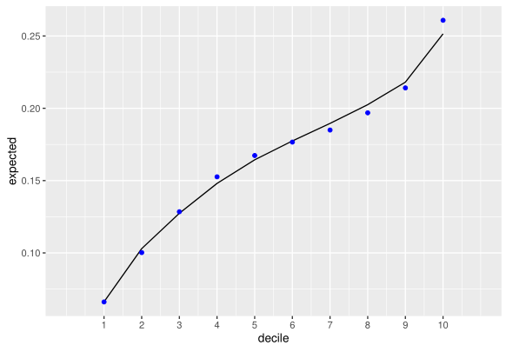
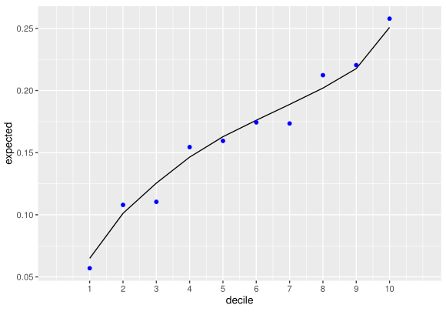
Conclusion
TRAINING
Holdout Test
80% of clients in Training
20% of clients in Testing
Building Decile Plots
Sort based on predictions
Group into 10 equally sized deciles
Plot actual frequency and expected frequency
Evaluating Decile Plots
Lift
Predictive Accuracy
Monotonicity
TESTING

